Slide 1
Muhammad Muzammil Siddiqui
Batch ‘23
BCS 1-J

Slide 2

Hi! I’m from Gulshan-e-Iqbal Town Karachi.
I’m 17 – years old!
I have completed my Matriculation from
BeaconHouse School System North Nazimabad
And my Intermediate from
Commecs College Gulistan-e-Jauhar

Slide 3
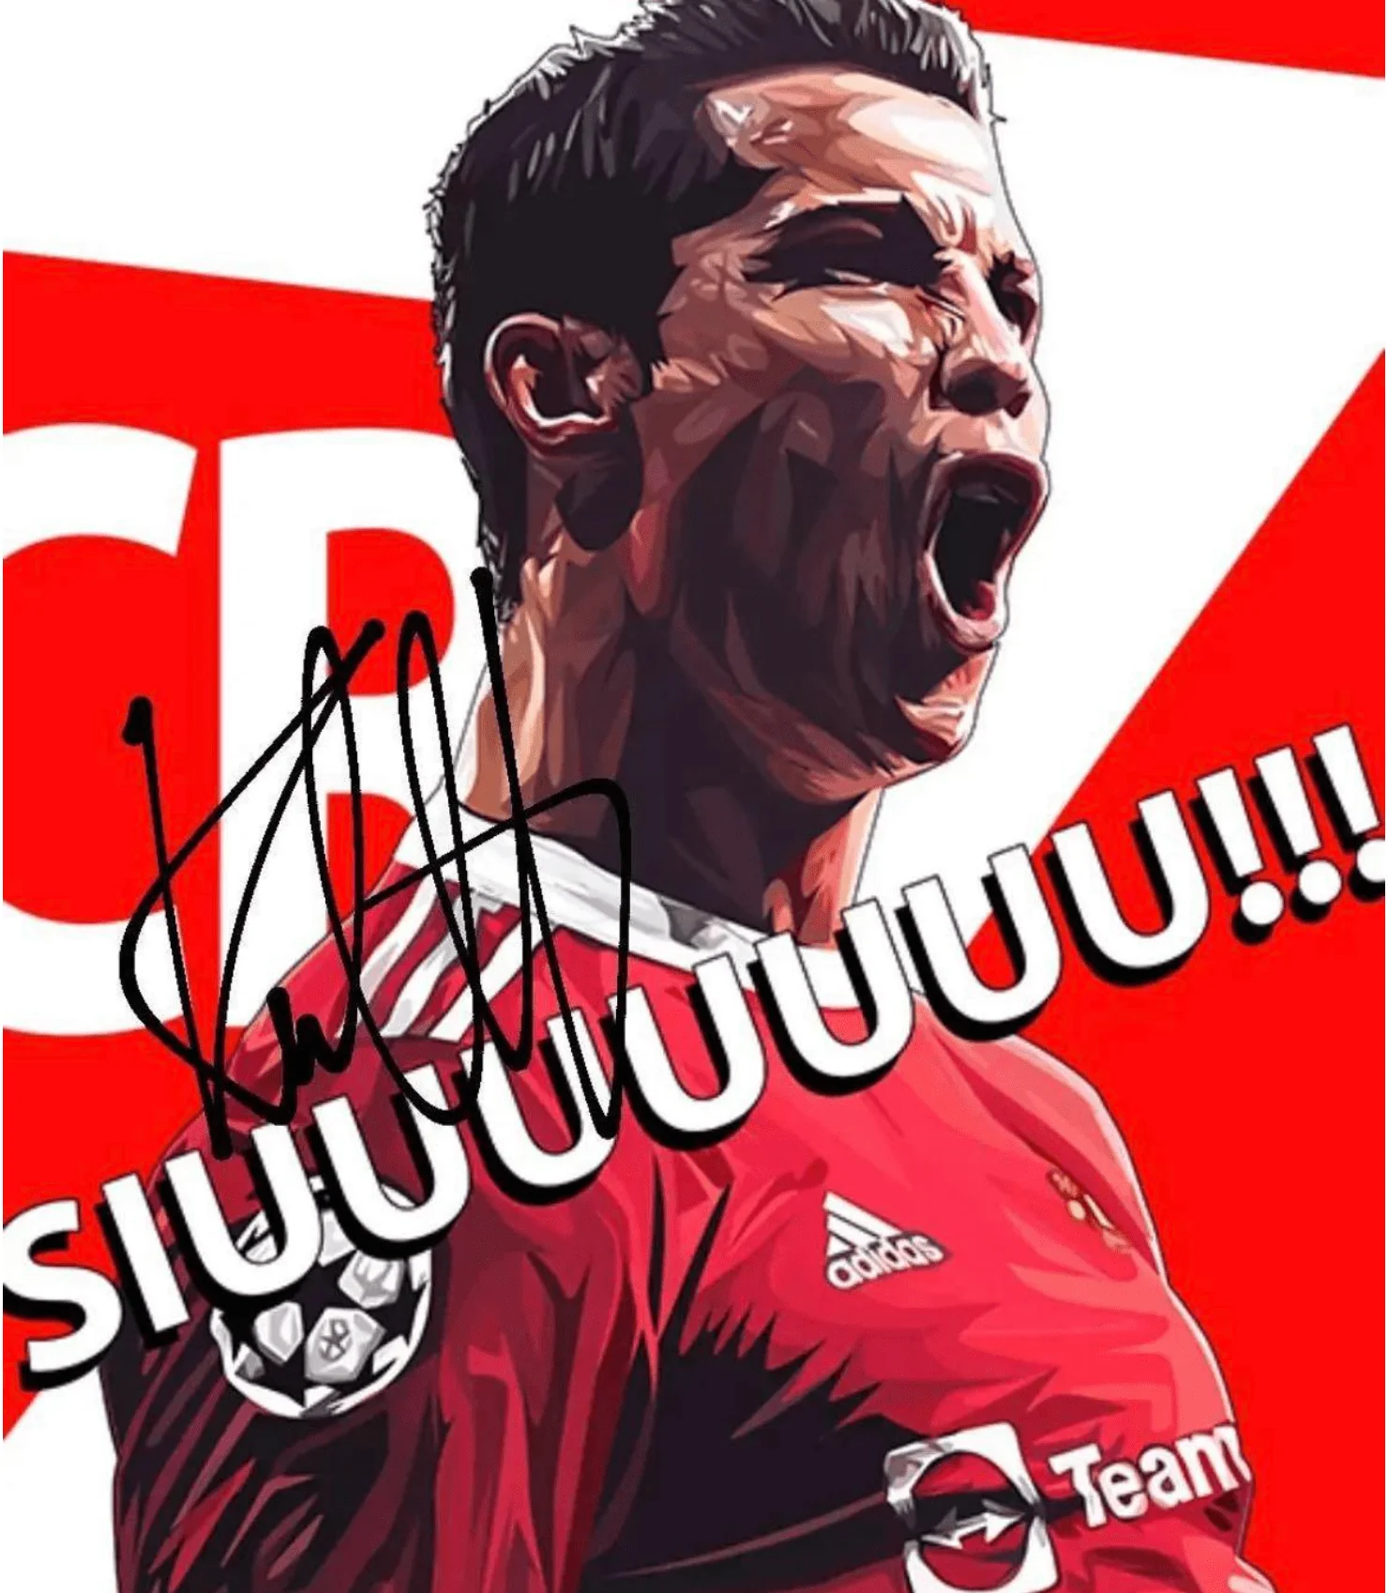
Hobbies
I have only ONE hobby
And that is
PLAYING FOOTBALL

Slide 4

Goals
My goal for this Semester is to
gain 3.8+ GPA
One challenge that I anticipate is Time Management as an student at FAST University

Slide 5
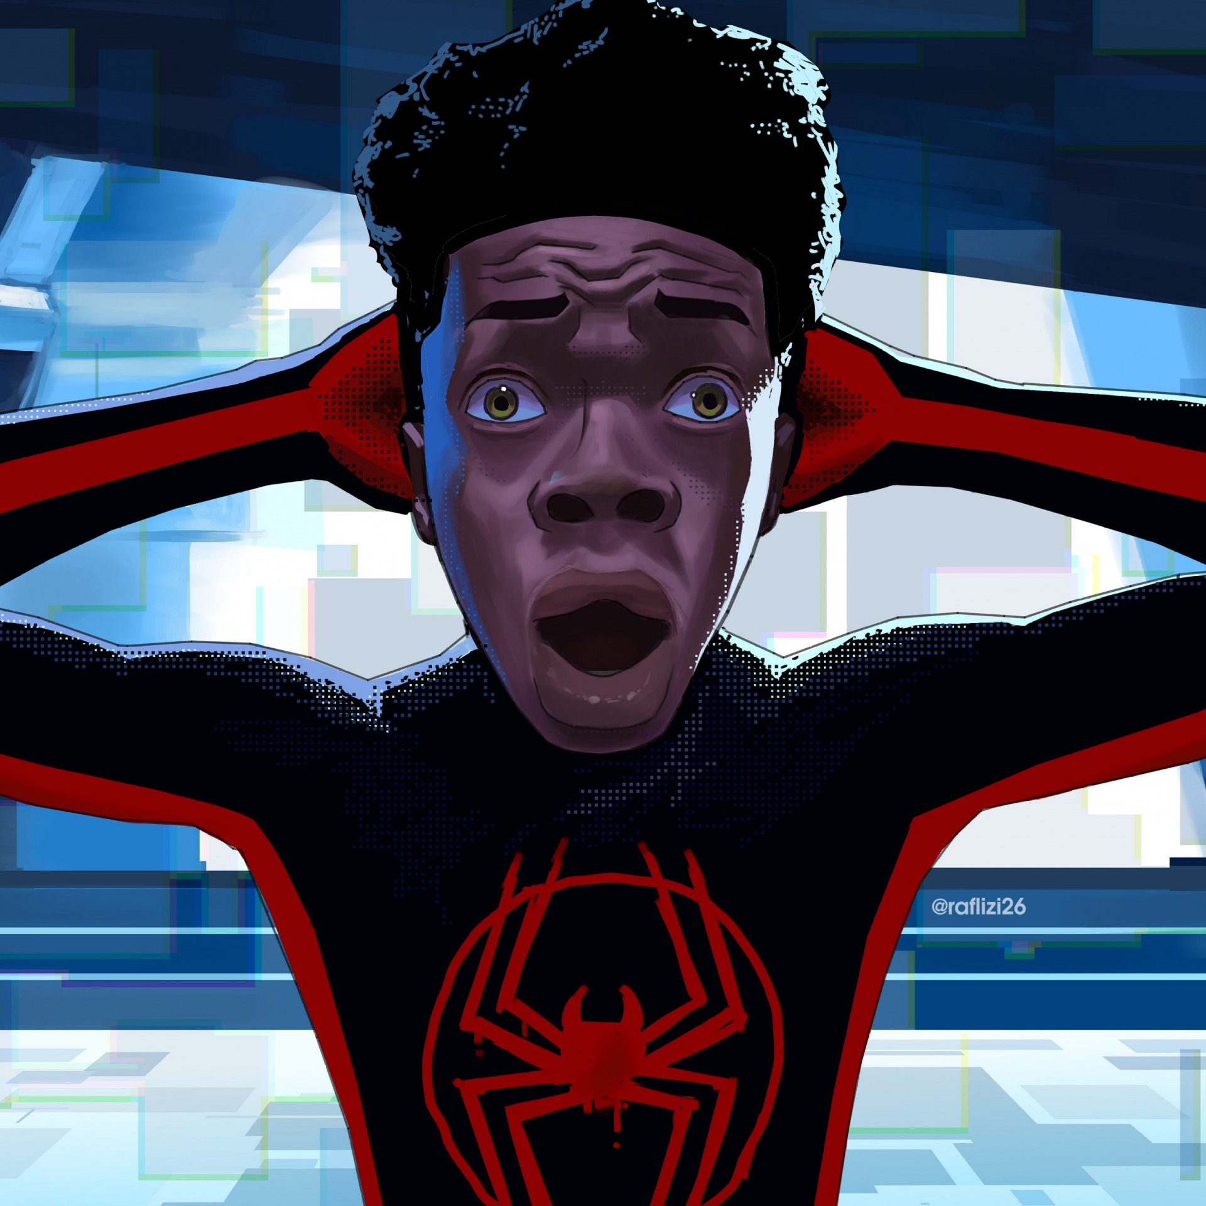
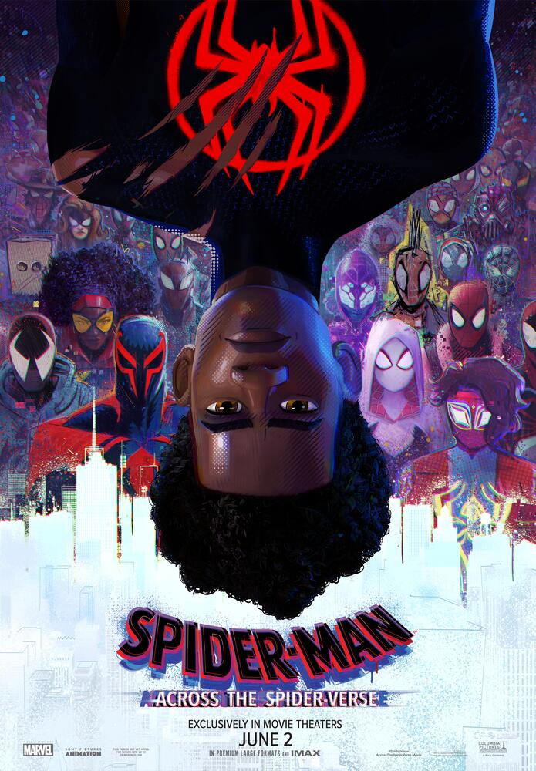
Favorite Movie
Currently, my favorite movie is Spiderman: Across the Spider-Verse
After reuniting with Gwen Stacy, Brooklyn's full-time, friendly neighborhood Spider-Man is catapulted across the Multiverse, where he encounters a team of Spider-People charged with protecting its very existence. However, when the heroes clash on handling a new threat, Miles finds himself pitted against the other Spiders. He must soon redefine what it means to be a hero so he can save the people he loves most.
I like the concept of the Multiverse in this movie, how the lead character paves his own story, and how distinct he is among all the other Spiders in the Multiverse

Slide 6
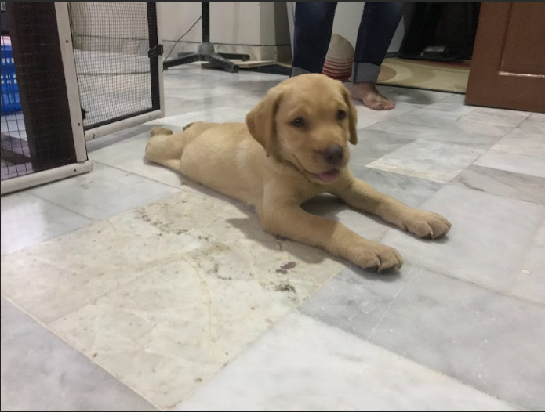
This is Betsy.
It was the first pet in our house of such category. It was a fine breed of Golden Retriever that my elder brother brought to our house. All of our family felt attached to it. Sadly it died within two months due to an illness.

Slide 7


One quote that inspires me is the iconic line by Harvey Dent in
“The Dark Knight”:
You either die a HERO or, live long enough to see yourself become the VILLAIN

Slide 8
Thankyou!

